Slide 1
PathFinder – A website compiling various colleges pathways
Anthony Sy (VC1A)
ANTHONY.SY50@bcmail.cuny.edu
Supervisor: Minh Le, MINH.LE@brooklyn.cuny.edu

Slide 2
Abstract
When entering a college, you can look at their official website to find information about their various pathways. For this project, I aim to compile all this information into one condensed database & website.
Completion of this project requires designing a user friendly & intuitive website, along with a working database connection.
The goal for this website can be used is when looking up local colleges, looking for all of a college’s pathways,

Slide 3

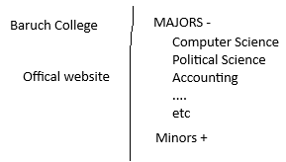
Website Interface
This is the base design of the website.
The initial page will have a search bar that allows the user to either search by county, or school name
When a school has been selected, it will show the pathways listed by Majors and Minors.

Slide 4
Use Case
The user will come into the page with the intent of looking at various colleges/universities.
They will search by county to find all their local schools.
After selecting a school, they are brought to a page with their respective given pathways
This gives them the option to select which one they are interested in.
After clicking on the pathway they want, it will send them to a new page.
The new page will have an embedded image of the pathway as well as a directory to the original location of the information.

Slide 5
Data sources used so far
CUNYs
Brooklyn College
KingsBorough Community College
Baruch College
….
Depending on how much time is spent and left, more will be used.

Slide 6
Tools used for project
IDE for website creation – Visual Studio Code
Using TailWind extension library
DB – MySQL
Data scraper - Scrapy
Microsoft Excel
Used for holding data
Note: These tools are subjected to change

Slide 7
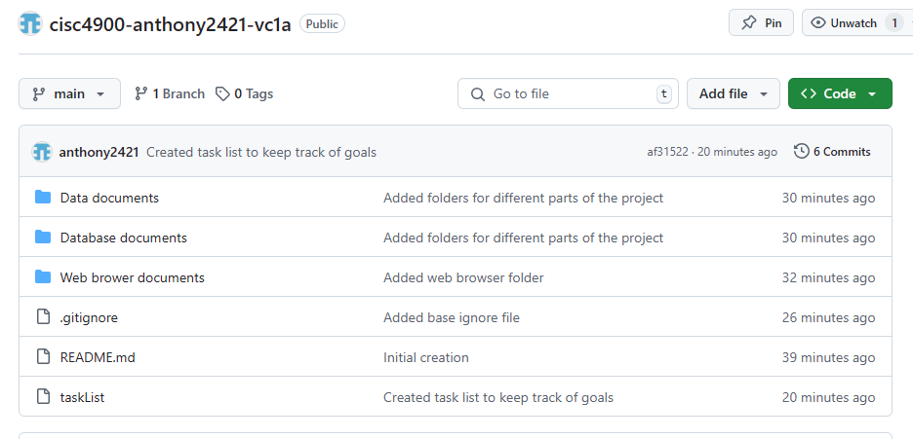
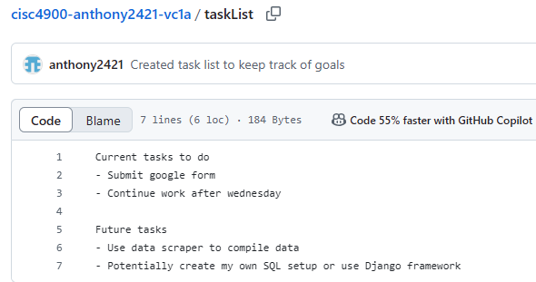
GitHub Repository
Original Repository
https://github.com/anthony2421?tab=repositories
Project Management
cisc4900-anthony2421-vc1a/taskList at main · anthony2421/cisc4900-anthony2421-vc1a

Slide 8
Planned Progression Schedule
As of updating this PowerPoint, it is the end of week 7
Week 4-8
Relearn HTML, CSS. Create base website & learn JavaScript
Week 8-11
Create database & connect it with website, bell and whistles
Week 12-14
Post project on public threads, get user reactions & comments.(Potentially)
Data Scrap for scoped information.
Week 14-16
Final bug fixes & adjustments
Final Submission on 5/12
Schedule is subjected to change as progression happens

